Slide 1
ESE516 A8 - ASSEMBLY
Eduardo Garcia
March 29th, 2022

Slide 2
SYSTEM ARCHITECTURE
5V
Seesaw 4x4 Keypad
I2C Bus
SAMW25 Xplained Pro
PA09-SCL
PA08-SDA
I2C (Sercom 0)
Grove I2C IMU
3v3

Slide 3
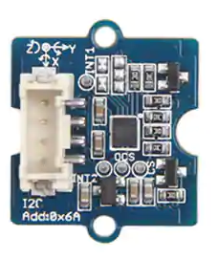
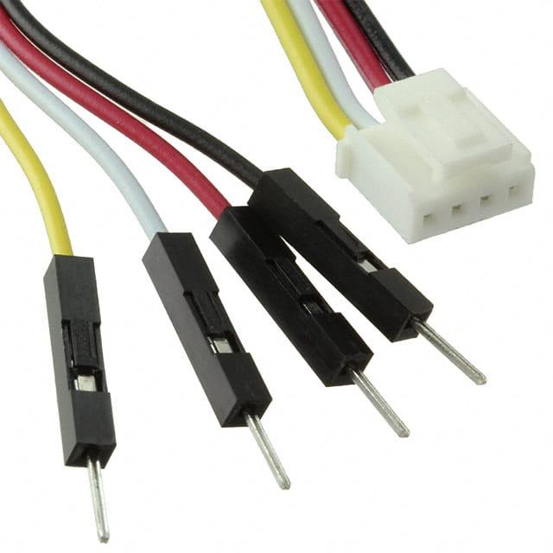
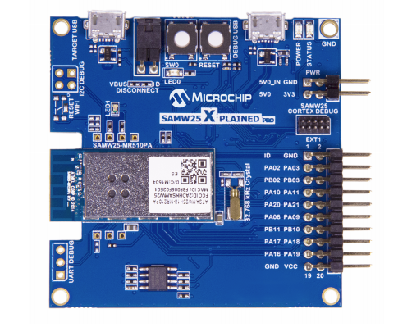
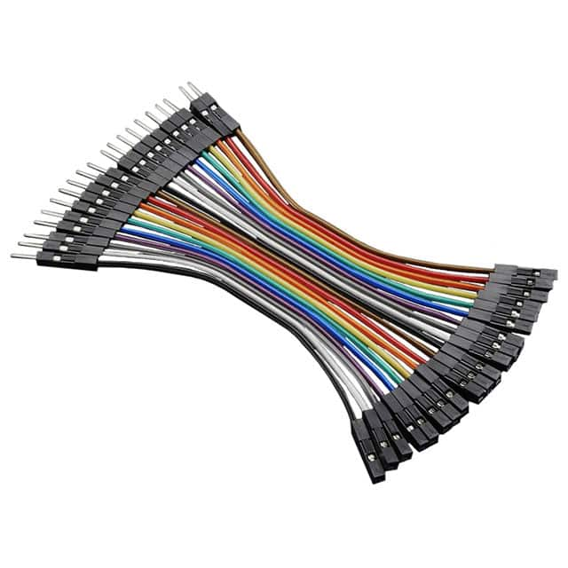
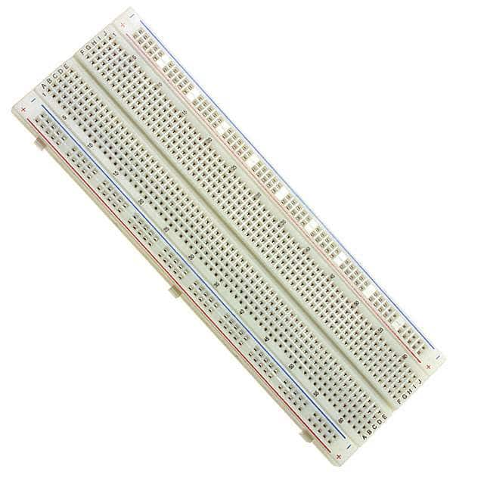
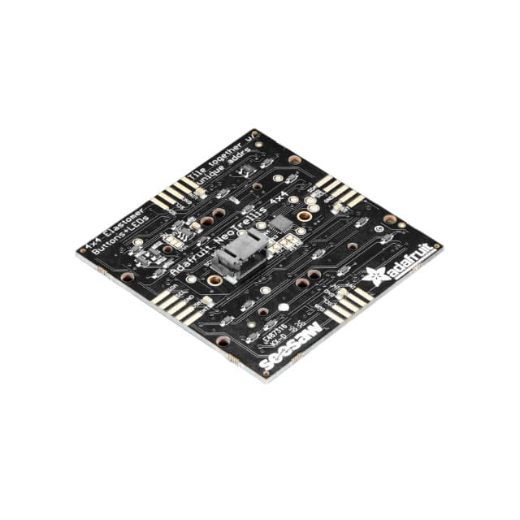
Assembly
Note:
2022 ACCELEROMETER is different, but it is still same connections!
I2C: PA08 – SDA
PA09 - SCL

Slide 4
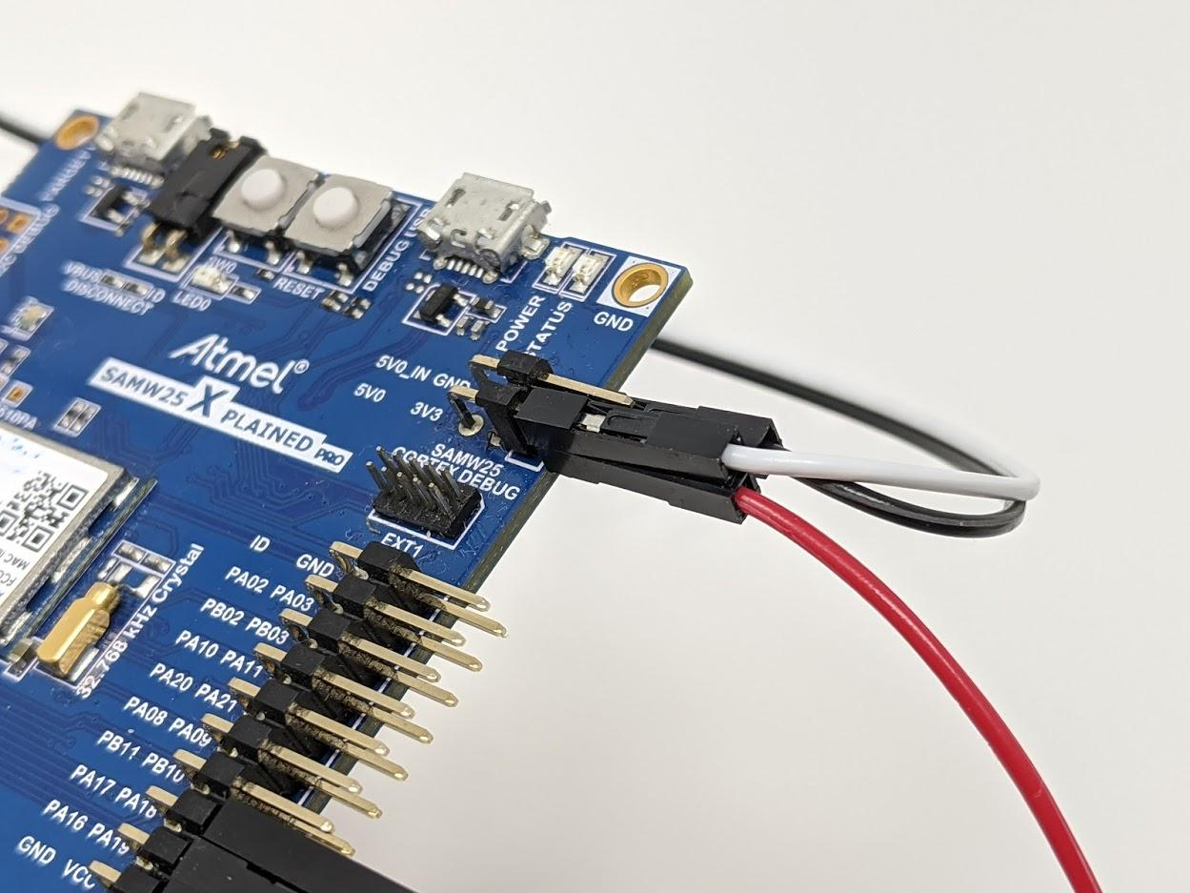
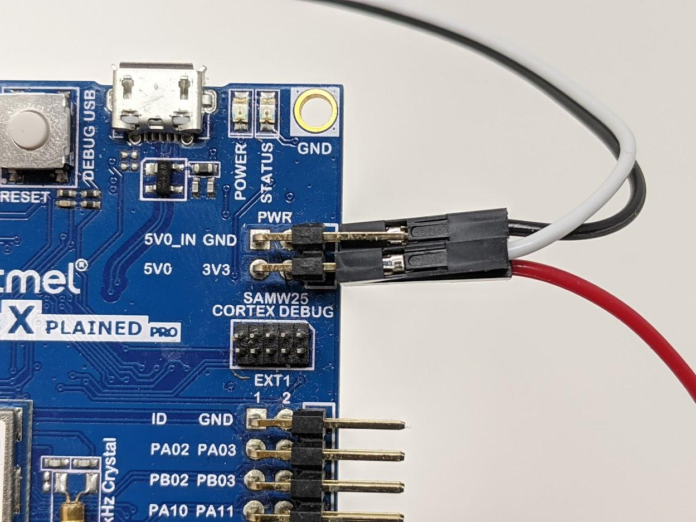
BUILD – CONNECTING POWER
Connect a red F-M Dupont jumper to 3V3
Connect a black F-M Jumper to GND
Connect a white F-M jumper to 5VO
GND (Bottom Right)
5VO (Top Left)
3V3 (Bottom Left)

Slide 5
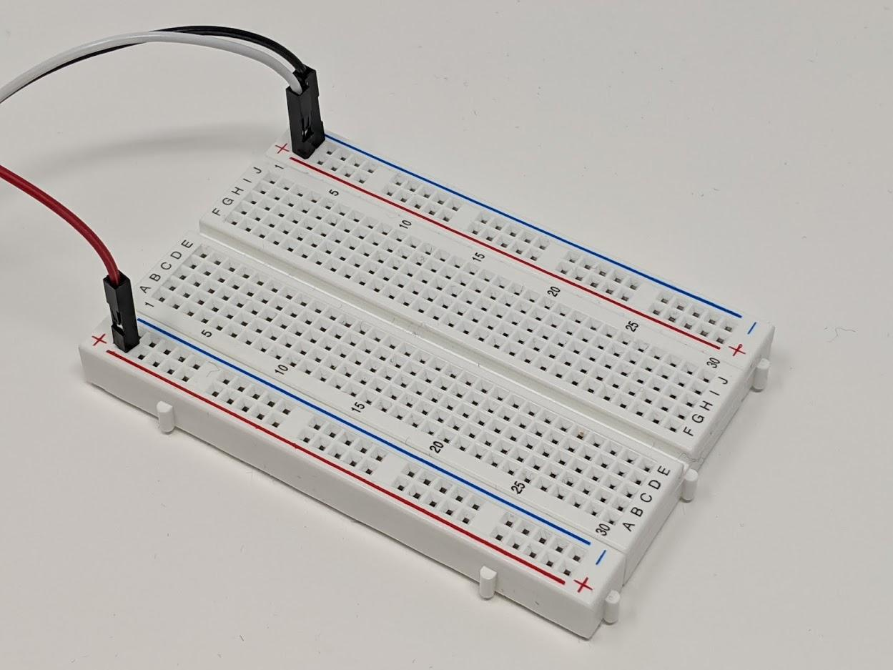
BUILD – CONNECTING POWER
Connect the other side of the RED wire to the BOTTOM POSITIVE RAIL (RED LINE)
Connect the other side of the WHITE wire to the UPPER POSITIVE RAIL (RED LINE)
Connect the other side of the BLACK wire to the upper NEGATIVE RAIL (BLUE LINE)
GND (Upper negative Line)
5VO (Top Positive Rail)
3V3 (Bottom Positive Line)

Slide 6
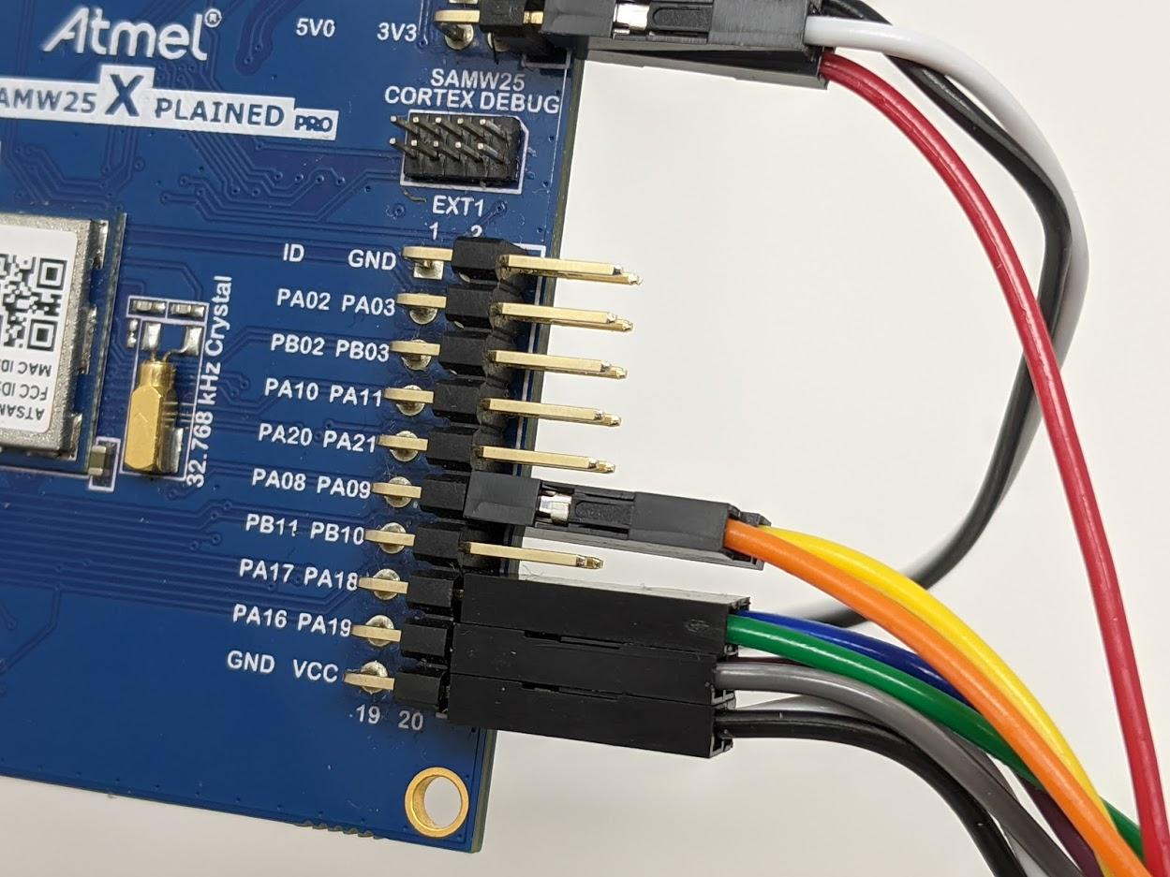
BUILD – CONNECTING I2C
Connect a ORANGE F-M Dupont jumper to PA08 (I2C SDA)
Connect a YELLOW F-M Jumper to PA09 (I2C SCL)
(Please ignore jumpers on PA16-PA19)
PA08 - SDA
PA09 - SCL

Slide 7
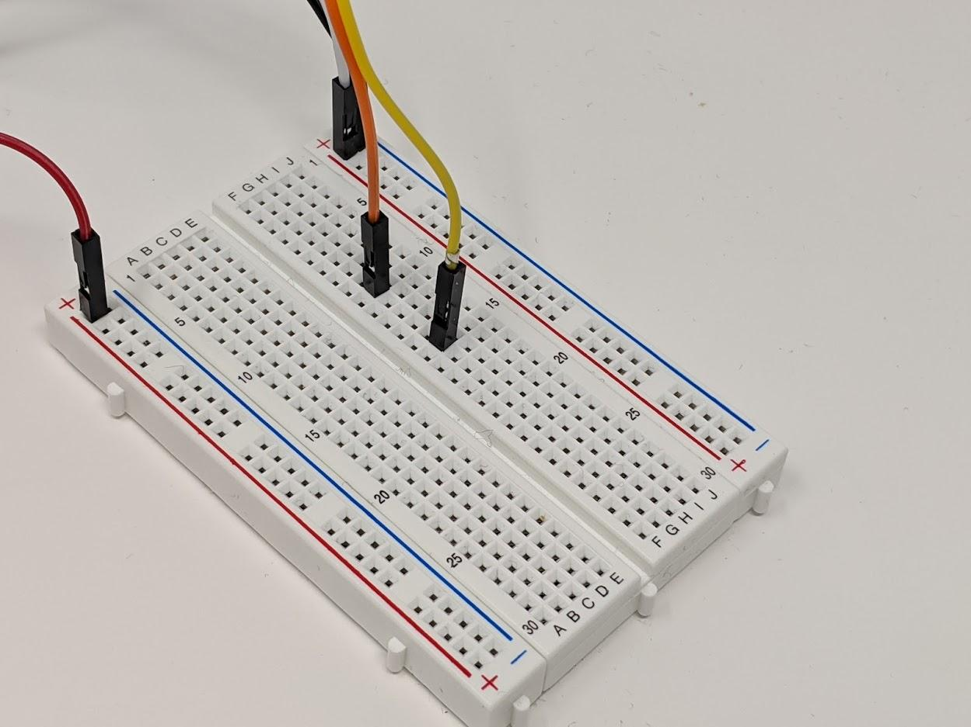
BUILD – CONNECTING I2C
PA08 - SDA
Connect the other side of the ORANGE cable to column 10 of the breadboard
Connect the other side of the YELLOW cable to column 15 of the breadboard
Now we have the I2C on the breadboard. We will now proceed to connect the I2C Sensors
PA09 - SCL

Slide 8
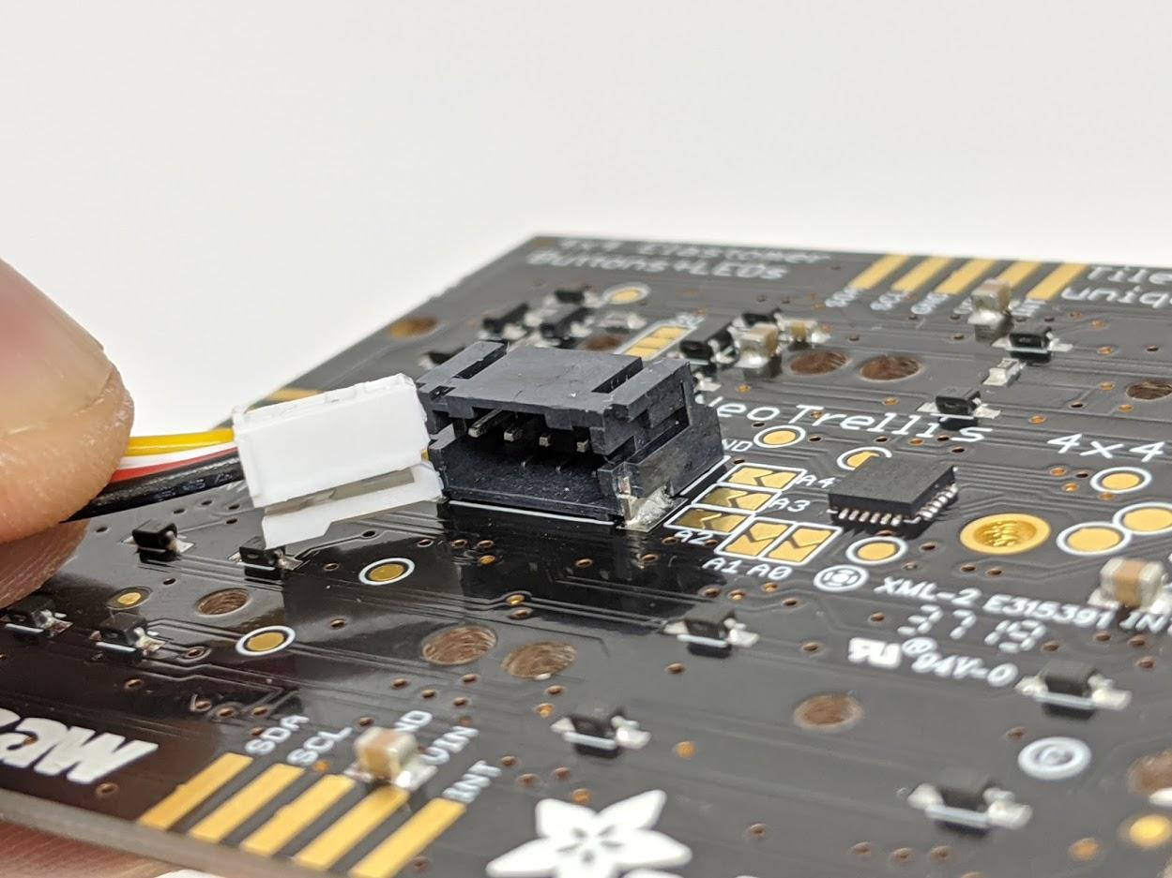
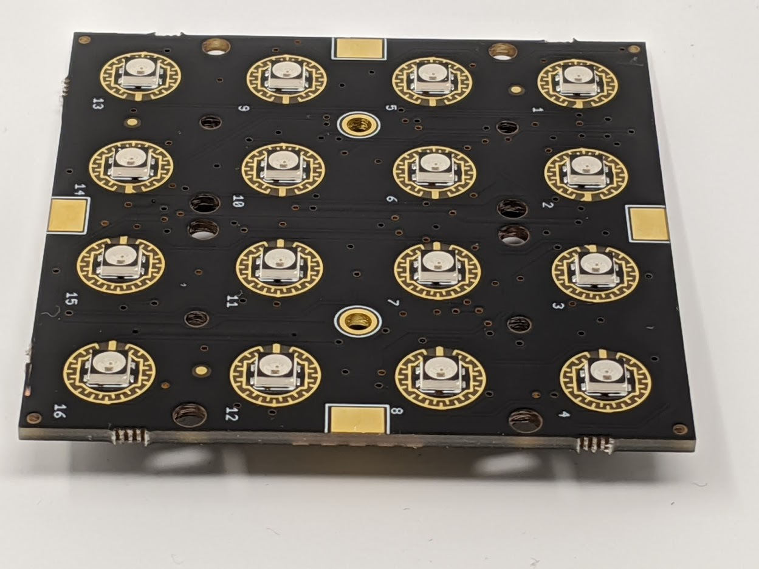
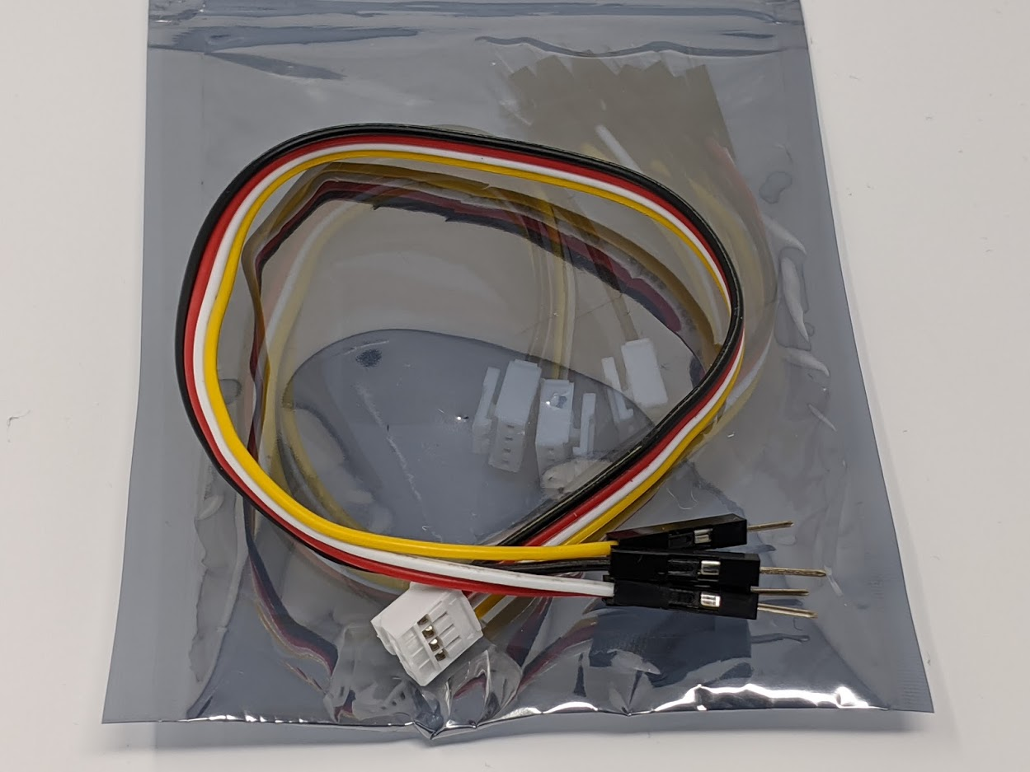
BUILD- CONNECTING THE SEESAW 4X4
Grab the Groove Connectors (Item H) and the Adafruit 4X4 button PCB (Item D)
Unfortunately as shown on the picture below the connector will not fit because of the detent! We will have to remove it, as we will see in the following slide.
???

Slide 9
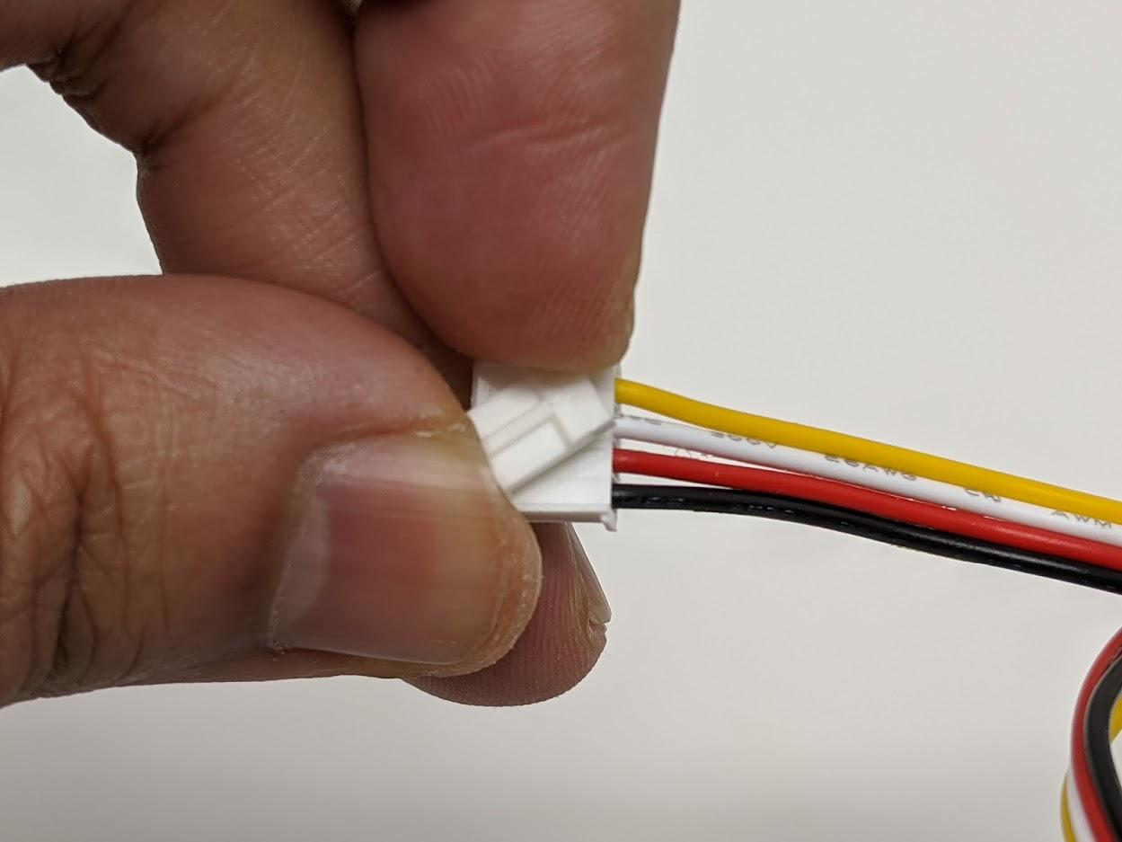
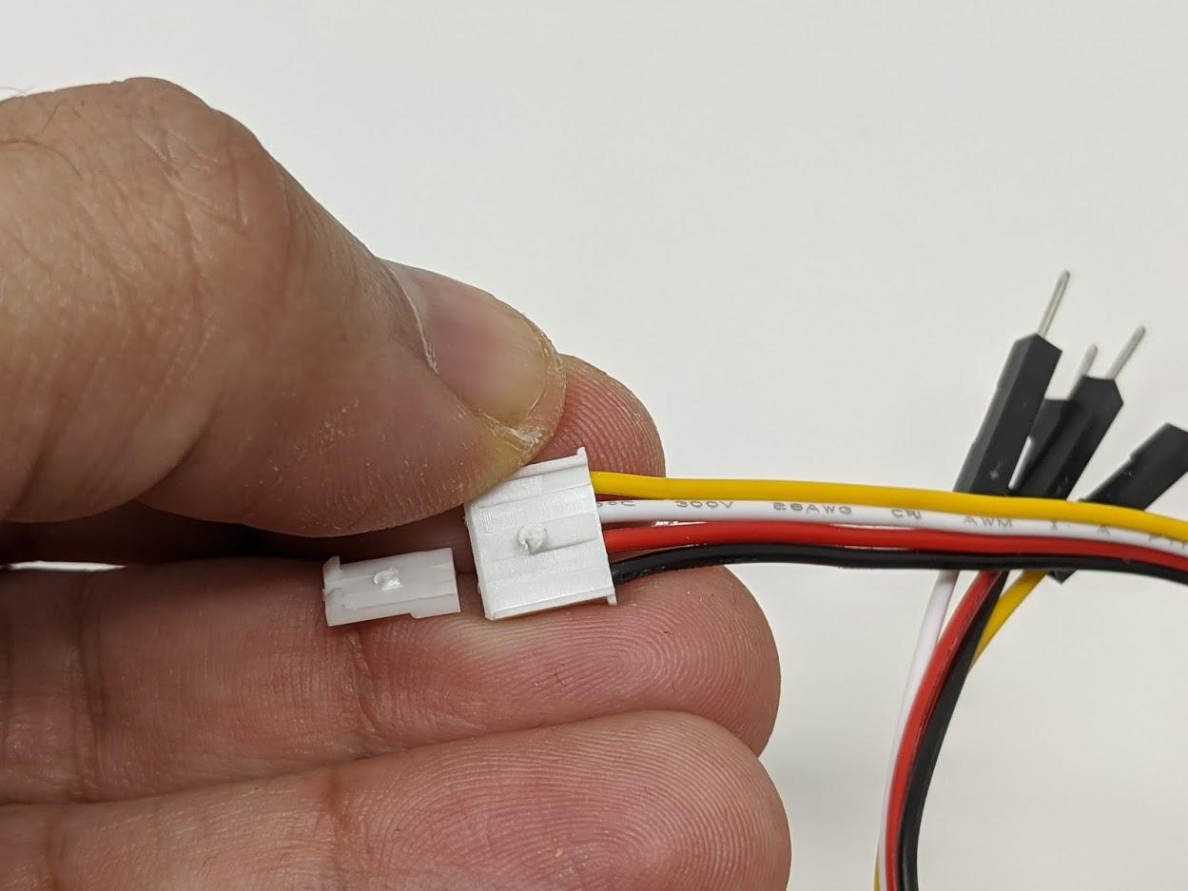
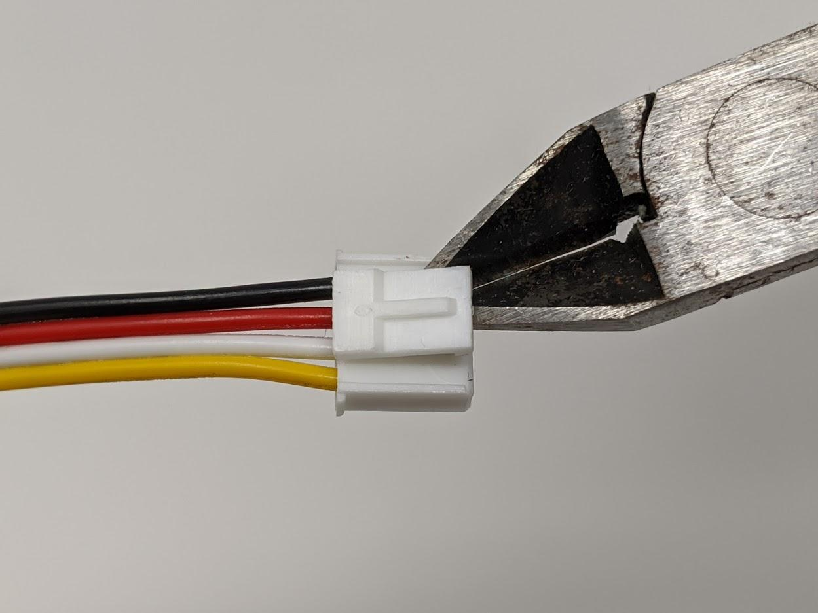
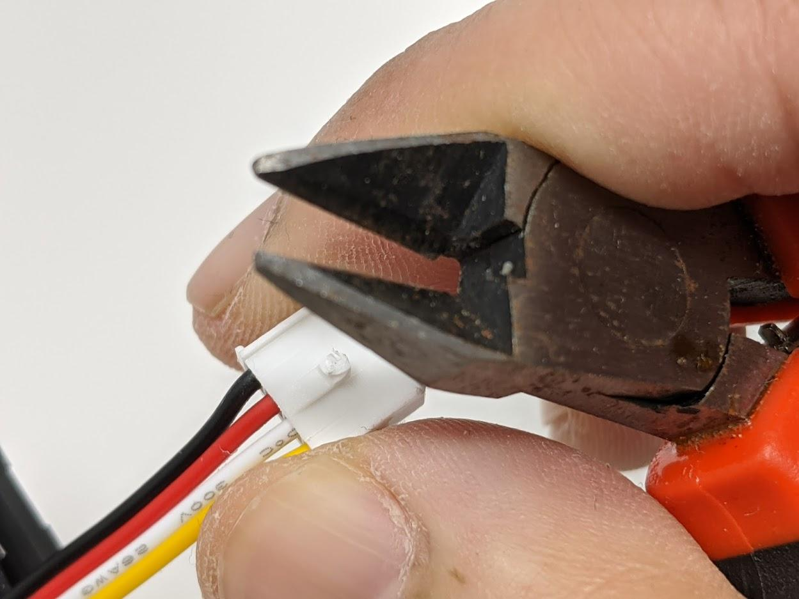
BUILD- CONNECTING THE SEESAW 4X4
To remove the detent, you can twist it until it breaks off!
If you have a tool like a wire cutter, you can cut it off – but please be careful! The first method explained above is better.

Slide 10
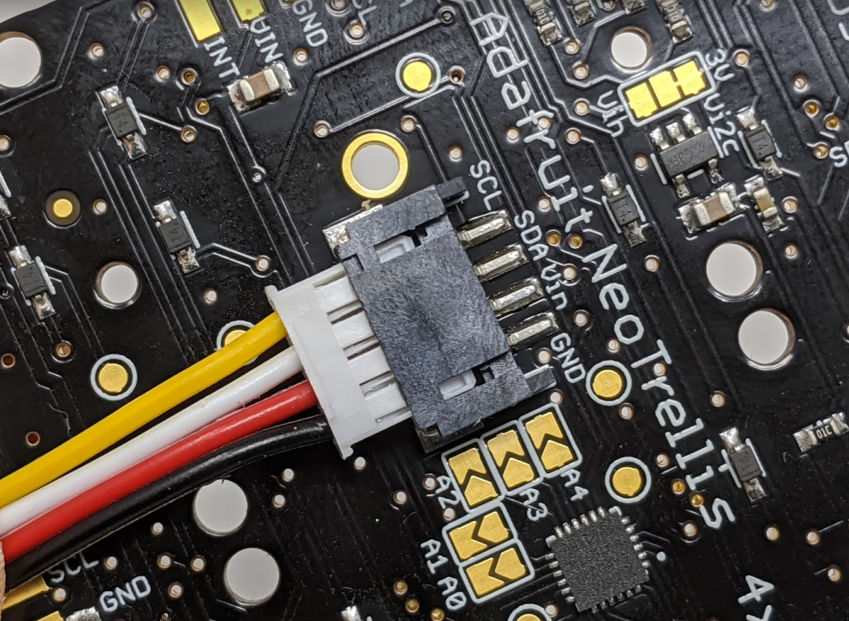
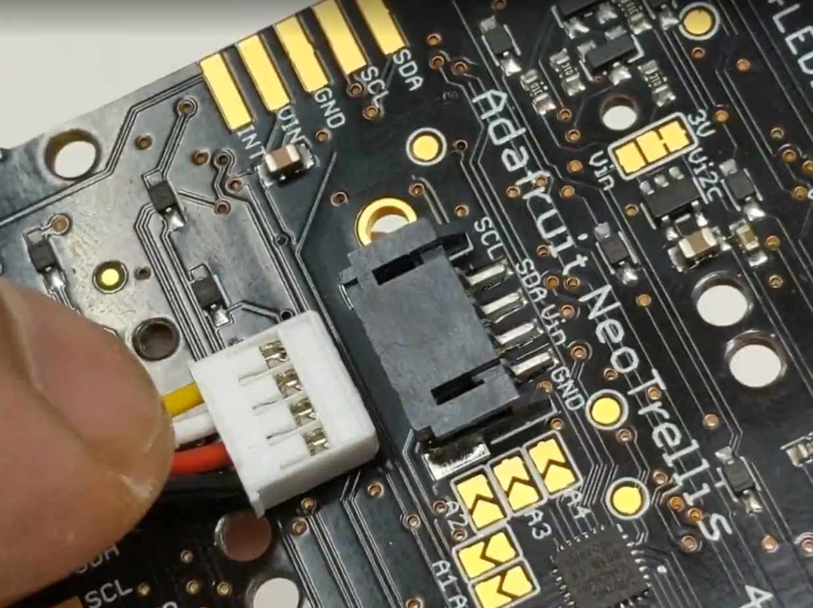
BUILD- CONNECTING THE SEESAW 4X4
Connect the connector into the Seesaw. Notice that the BLACK wire is to the right, aligning with the GND Pin.
BE CAREFUL TO NOT PLUG IT BACWARKS!
Remove detent faces downward
Black wire to the right aligning with GND
Black wire to the right aligning with GND
The connector goes in until here!

Slide 11
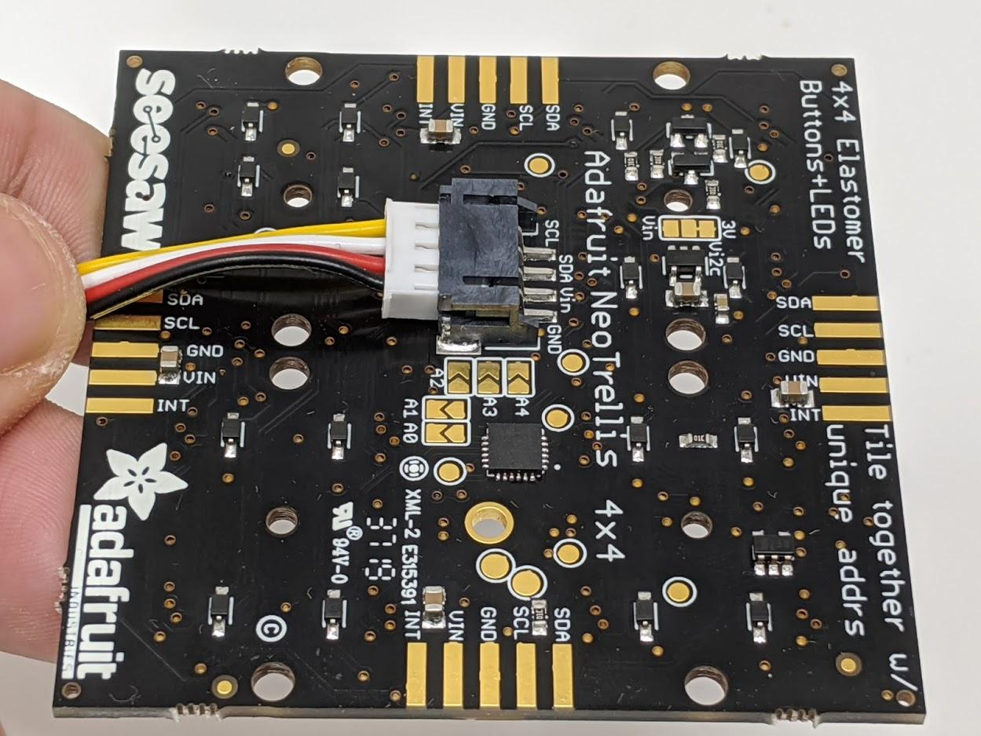
BUILD- CONNECTING THE SEESAW 4X4 – ANOTHER VIEW
Connect the connector into the Seesaw. Notice that the BLACK wire is to the right, aligning with the GND Pin.
BE CAREFUL TO NOT PLUG IT BACWARKS!
Black wire to the right aligning with GND
Remove detent faces downward
Black wire to the right aligning with GND

Slide 12
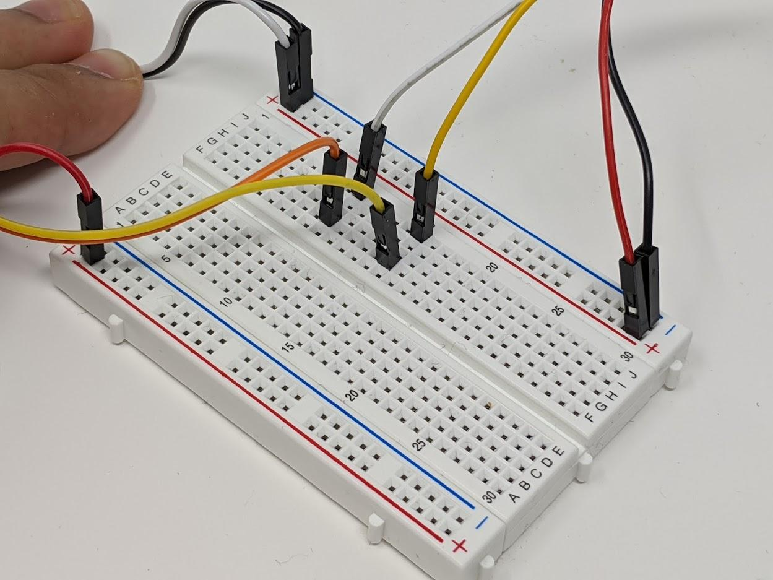
BUILD- CONNECTING THE SEESAW
Connect the other side of the WHITE cable to column 10 of the breadboard (SDA)
Connect the other side of the YELLOW cable to column 15 of the breadboard (SDA)
Connect the other side of the BLACK cable to the upper NEGATIVE RAIL (gnd)
Connect the RED cable to the UPPER POSITIVE RAIL (5V).
Now we have the SEESAW I2C on the breadboard.
GND
PA08 - SDA
PA09 - SCL
5V

Slide 13
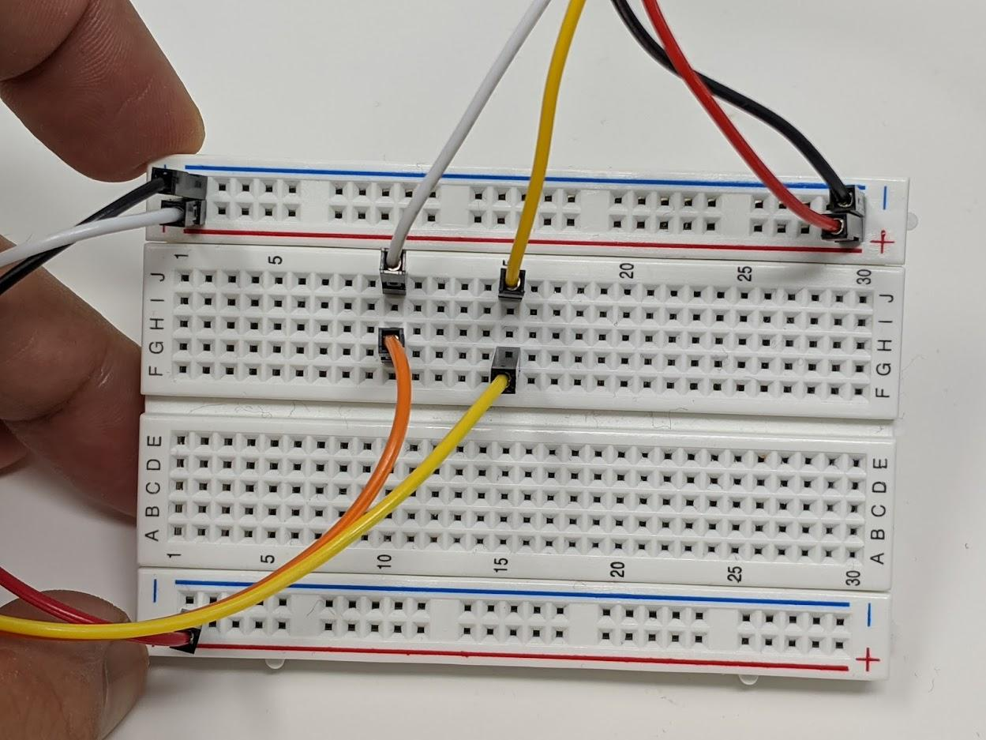
BUILD- CONNECTING THE SEESAW – ANOTHER VIEW
Connect the other side of the WHITE cable to column 10 of the breadboard (SDA)
Connect the other side of the YELLOW cable to column 15 of the breadboard (SDA)
Connect the other side of the BLACK cable to the upper NEGATIVE RAIL (gnd)
Connect the RED cable to the UPPER POSITIVE RAIL (5V).
Now we have the SEESAW I2C on the breadboard.

Slide 14
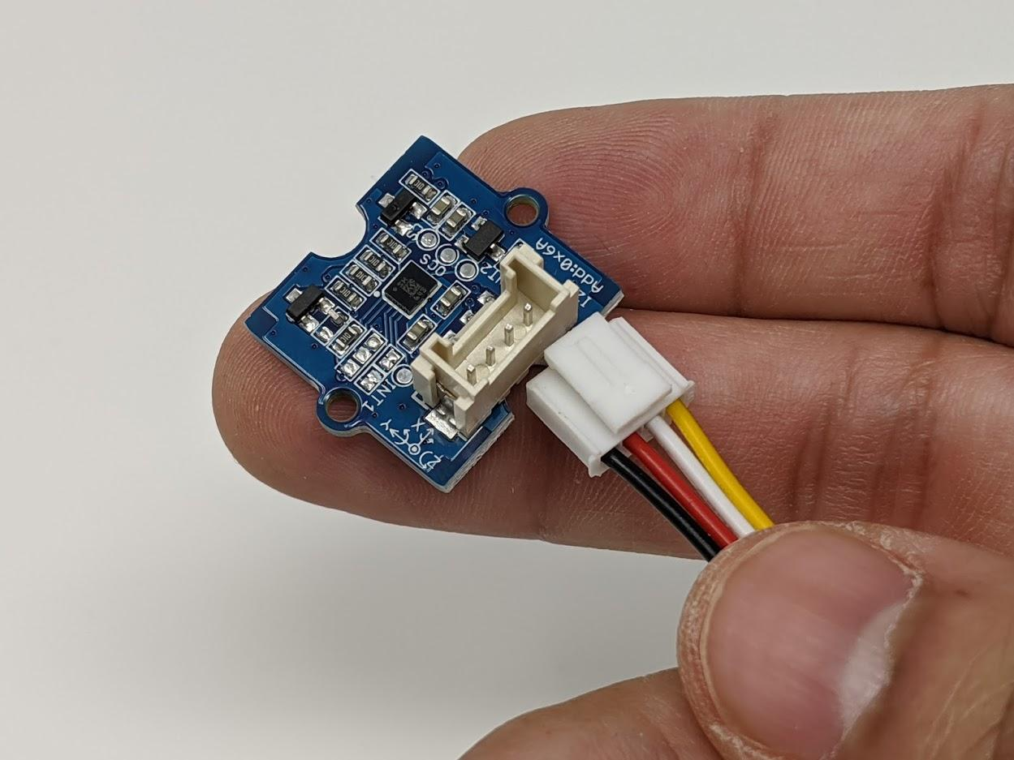
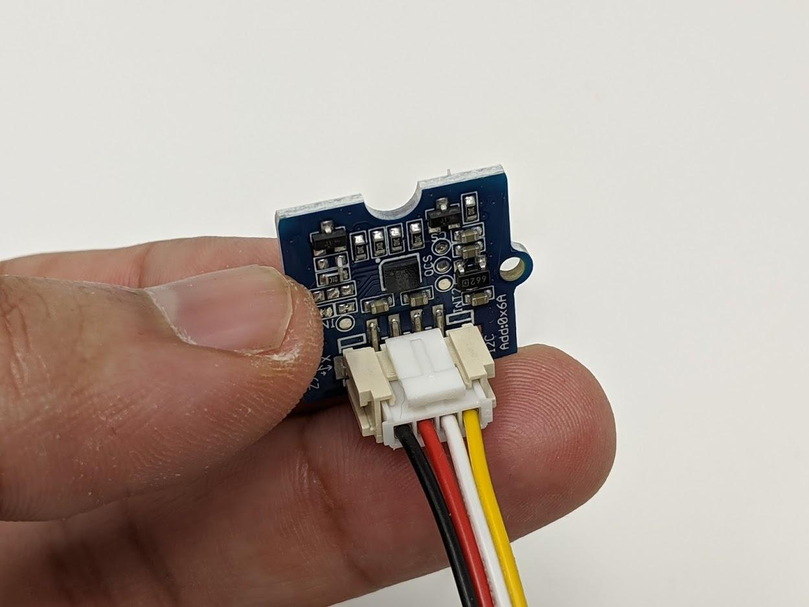
BUILD- CONNECTING THE ACCELEROMETER
Note:
2022 ACCELEROMETER is different, but it is still same connections!
Grab another Grove connector (Item H) and the accelerometer (Item G).
No need to break the detent on this connector! We can just plug it in as show on the pictures.

Slide 15
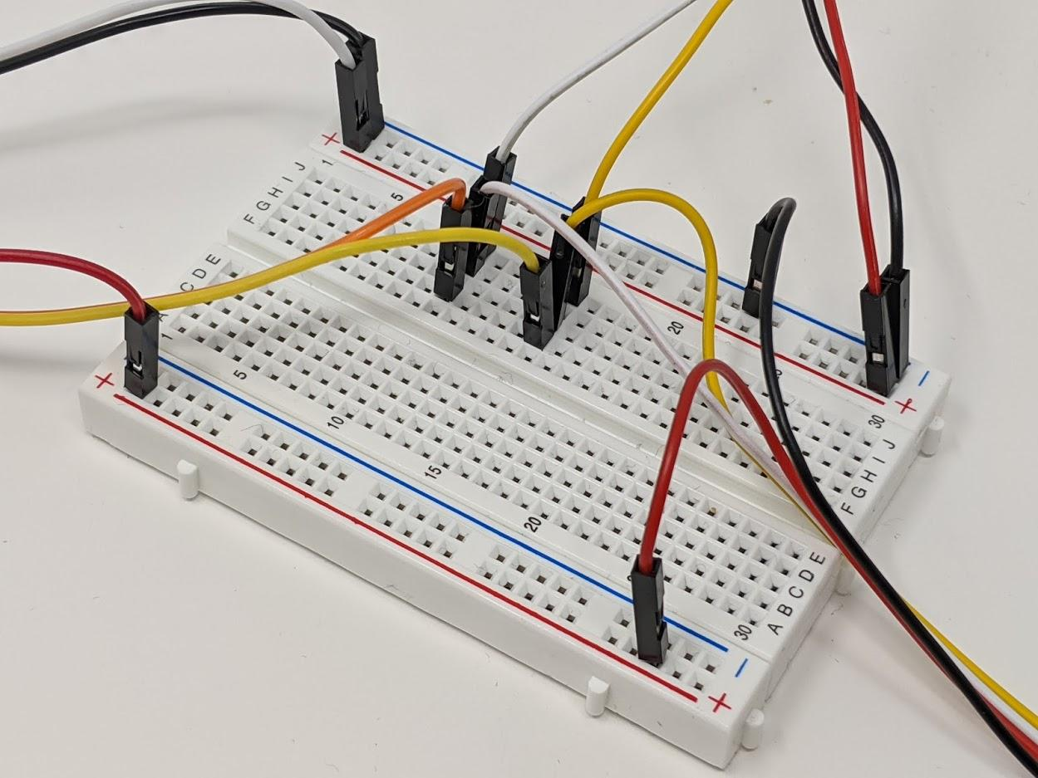
BUILD- CONNECTING THE ACCELEROMETER
Connect SDA cable to column 10 of the breadboard (SDA)
Connect SCL to column 15 of the breadboard (SCL)
Connect GND to the upper NEGATIVE RAIL (gnd)
Connect the VCC Cable to the LOWER POSITIVE RAIL (3.3V). This is the different than from the Seesaw!
Now we have all I2C devices on the breadboard.
PA08 - SDA
GND
PA09 - SCL
3.3V

Slide 16
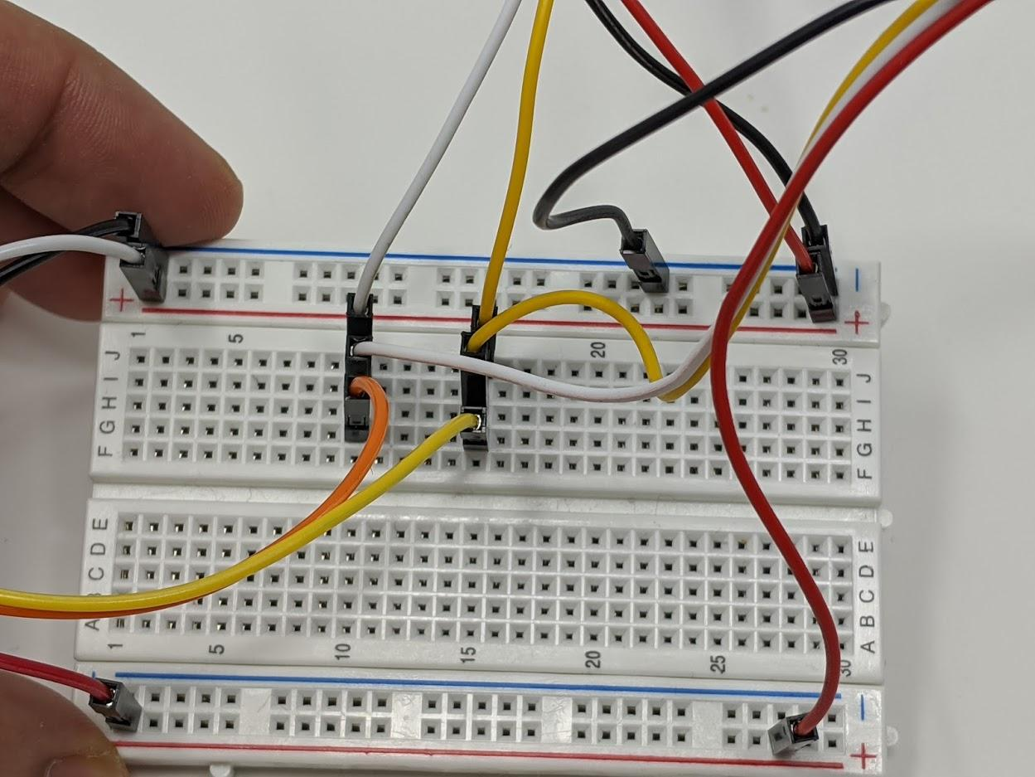
BUILD- CONNECTING THE ACCELEROMETER – ANOTHER VIEW
Note:
2022 ACCELEROMETER is different but is is still same connections!
Connect SDA cable to column 10 of the breadboard (SDA)
Connect SCL to column 15 of the breadboard (SCL)
Connect GND to the upper NEGATIVE RAIL (gnd)
Connect the VCC Cable to the LOWER POSITIVE RAIL (3.3V). This is the different than from the Seesaw!
Now we have all I2C devices on the breadboard.

